Slide 1
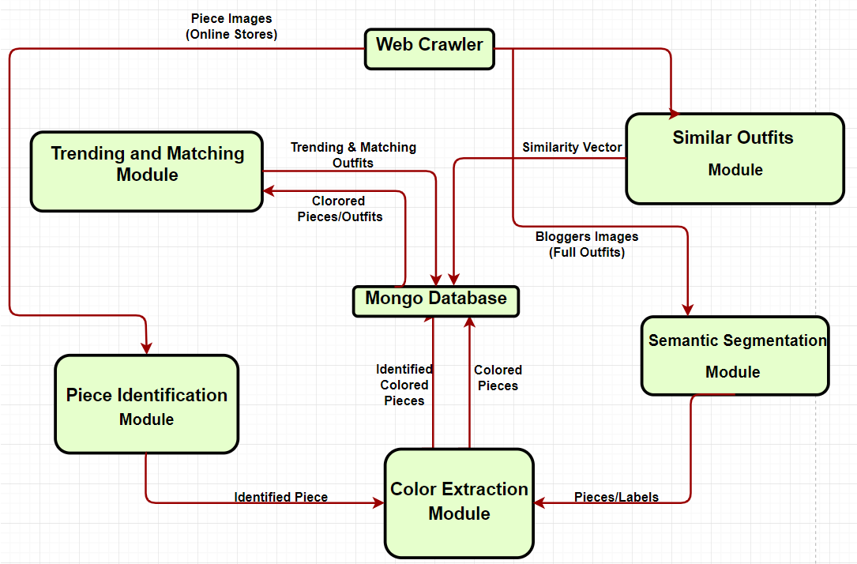
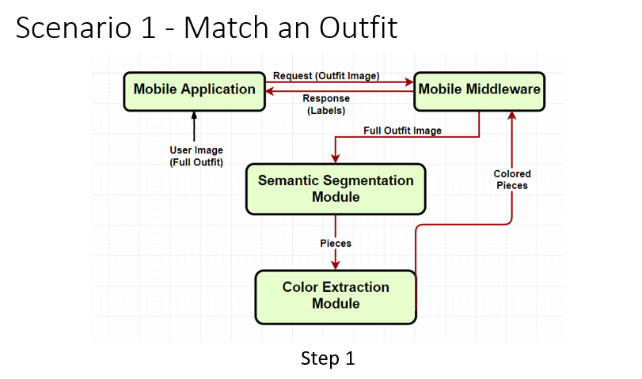
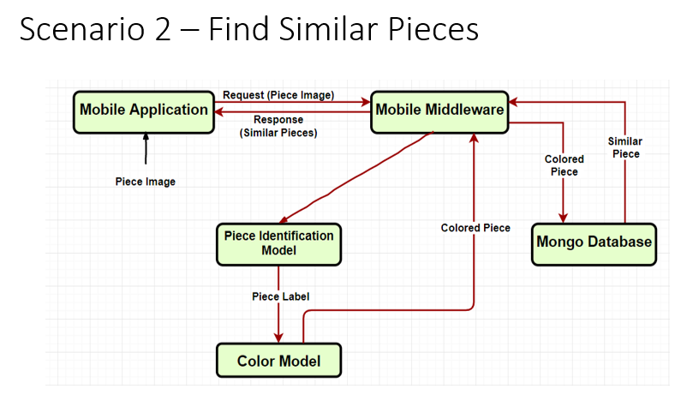
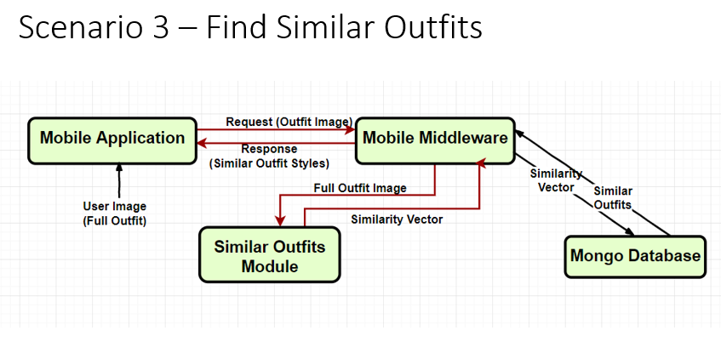
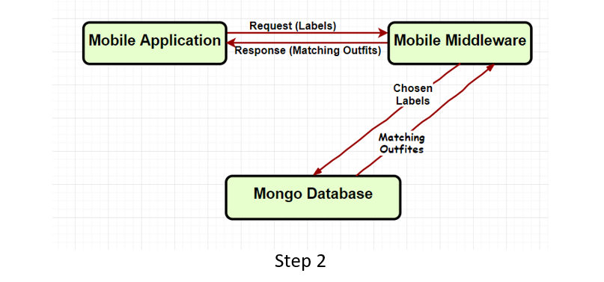
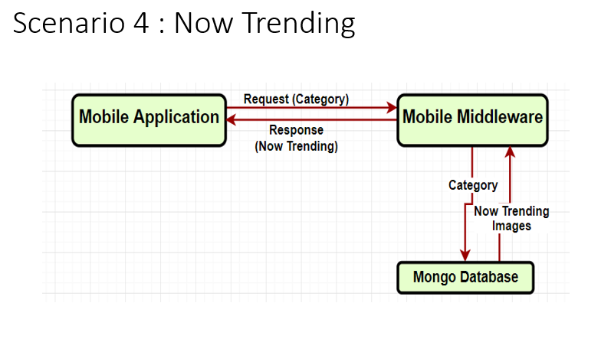
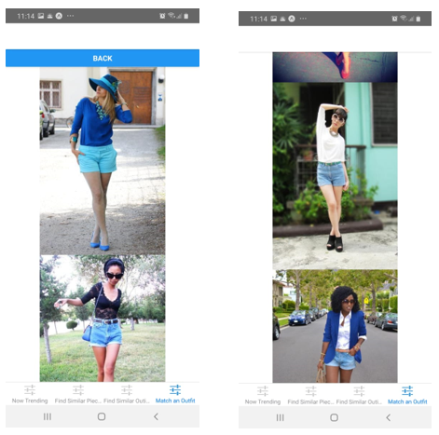
CCE – C
Graduation Project – Spring/2019
Shopping Pal
An application, supported by a set of artificial intelligence modules, that a user can use; to discover the trends nowadays, to find similar pieces to any piece provided by the user, to get recommendations for outfits suitable for any occasion, and finally, to get recommendations for other pieces that match (go with) another given piece provided by the user. The application can take any image as an input from the user and perform the mentioned functionalities on this photo. For example, the user can take an image of a yellow blouse and choose to get recommendations on other pieces that can go with this blouse that follows the global trend in fashion.
Application Main Features:
Find similar pieces.
Find similar outfits.
Find matching pieces.
Find Now-Trending colors and outfits.
Future Work:
Extra features: patterns, fabrics.
In-store pieces placement/organization.
Online shopping cross-selling.
Making contracts with the shopping stores.
Hussein Mohamed
Mohamed Osama
Salma Ibrahim
Yousra Hussein
Dr. Samir Shahin

